Slide 1
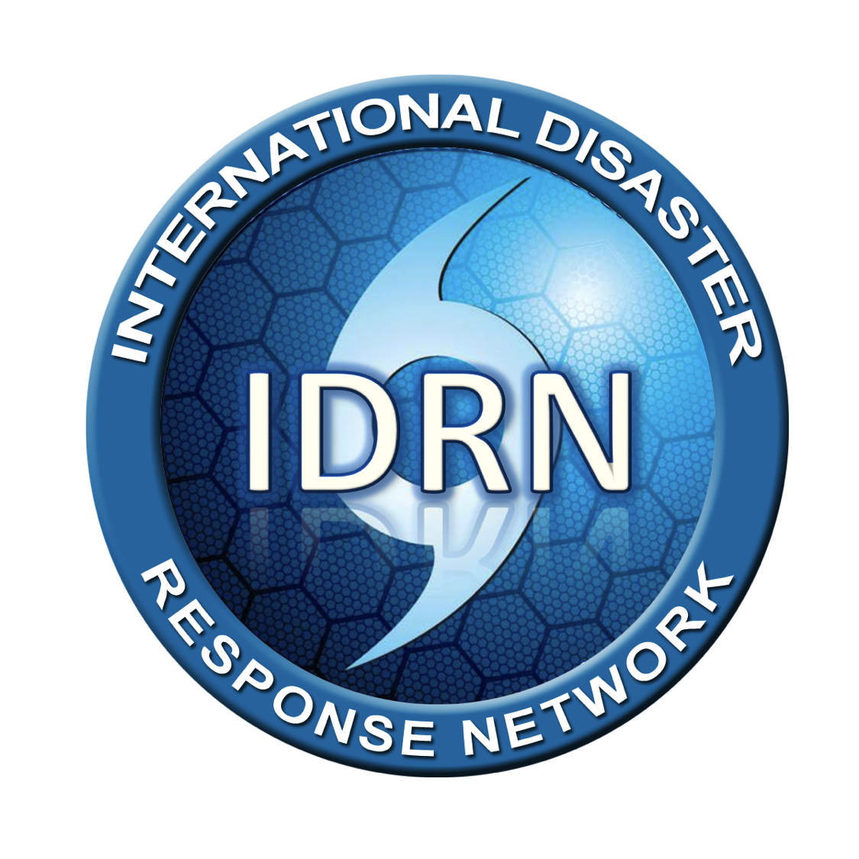

Slide 2

IDRN 1100
Belize
September, 2014

Slide 3

Disaster Preparedness
Why are you here?
Admin
  Exits
  Restrooms/Coffee/Lunch
  Participation Questions
Introductions
Why are you here?
  What is your expectation?
  What is your experience?

Slide 4
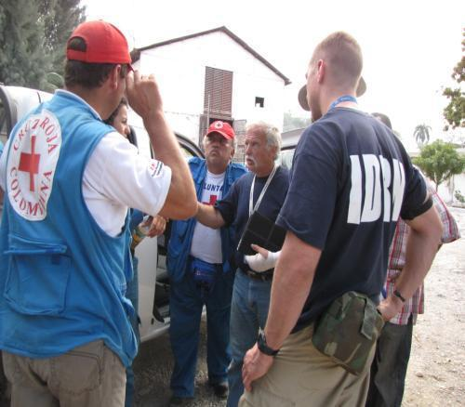
IDRN Courses
IDRN 1100 – CBDP
Community Based Disaster Preparedness
IDRN 1300 – CBDR
Community Based Disaster Response

Slide 5
Objectives
Understand
the
Causes and Impact
of
Disasters
Understand
How to create a family preparedness plan
Understand
the
Basics of Survival
Understand
the
Basics of Disaster Response
Be Prepared for Disasters as an individual/family

Slide 6
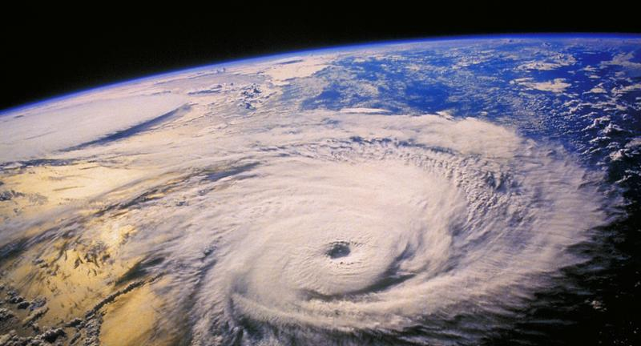
Why Prepare?

Slide 7
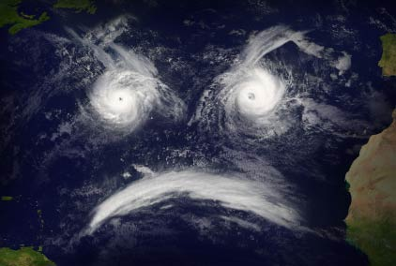
The Last 10 Years
“According to the figures released by the Center for Research on Epidemiology of Disasters in Geneva, 3,852 disasters killed more than 780,000 people over the past 10 years, affected more than 2 billion others and cost a minimum of us$960 billion”

Slide 8
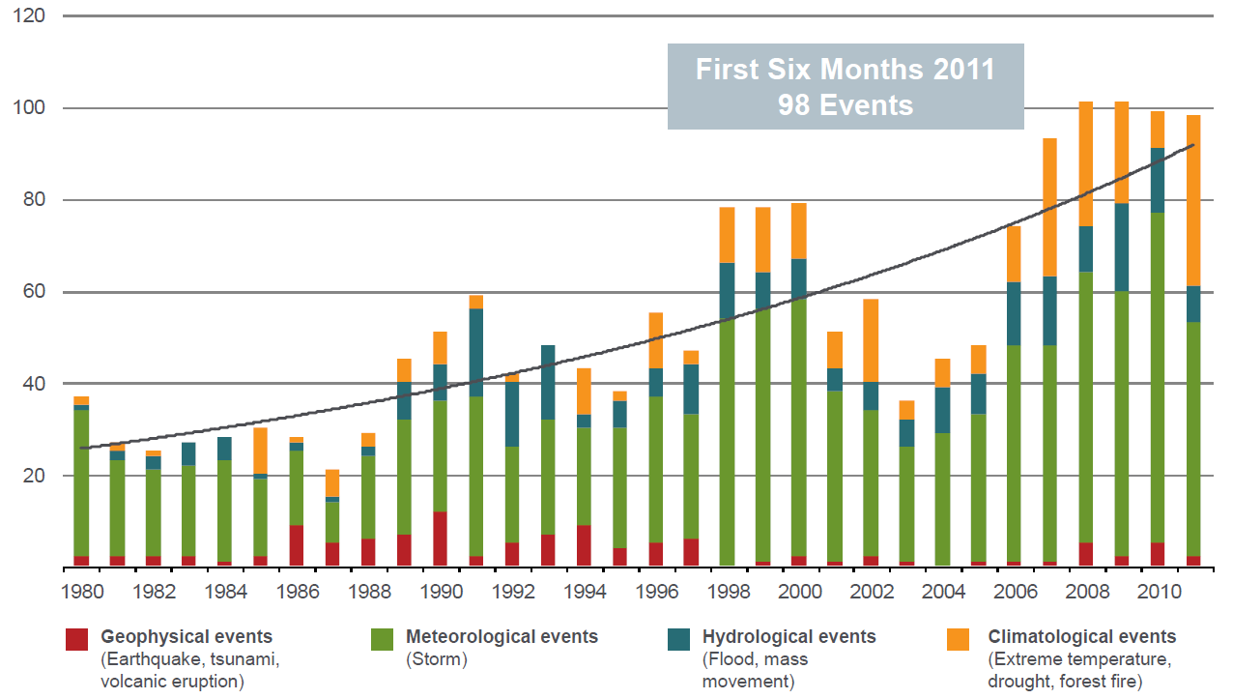

Slide 9
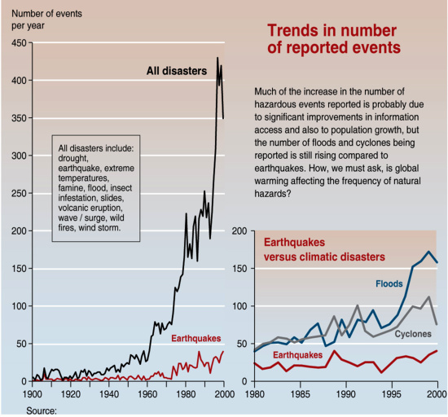
Some Natural Disasters are Increasing

Slide 10
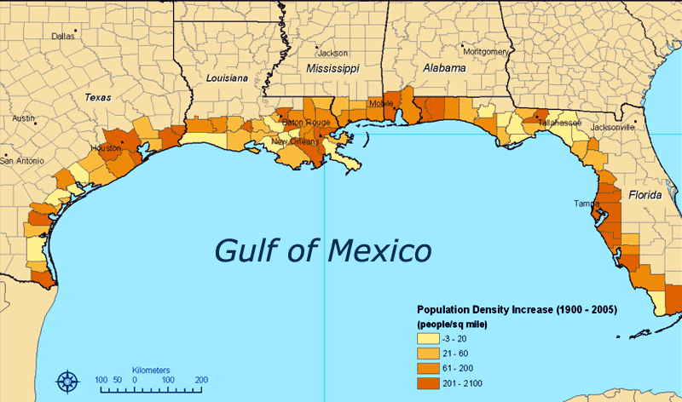

Slide 11
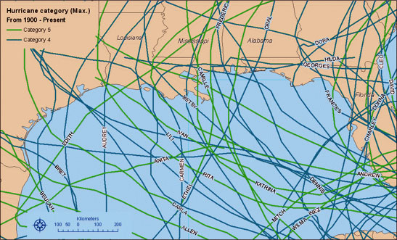

Slide 12
It can’t happen to me..
Consider the case of….
  Beirut – 551 AD
  Haiti - 2010
  New Madrid – 1800s
  Fukushima – 2011
  Colorado – 2012, 2013

Slide 13
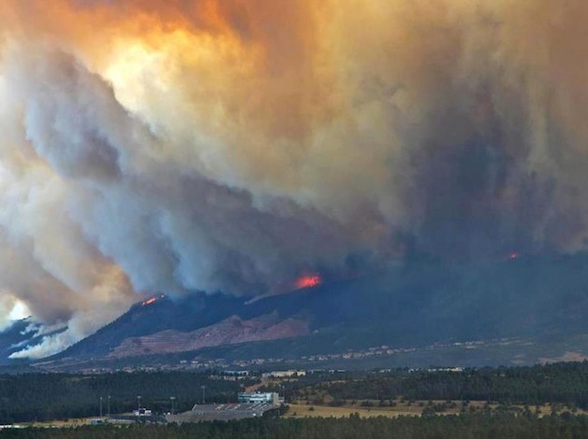

Slide 14
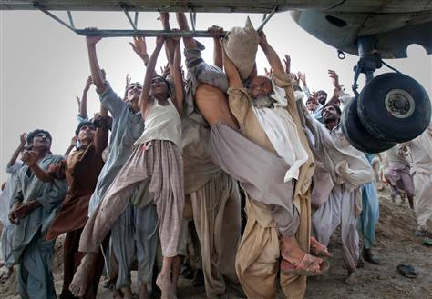
When Will Help Arrive?
Hours?
Days?
Weeks?
Never?
What is the capacity of the Government?
What does it consist of? IS that enough?

Slide 15
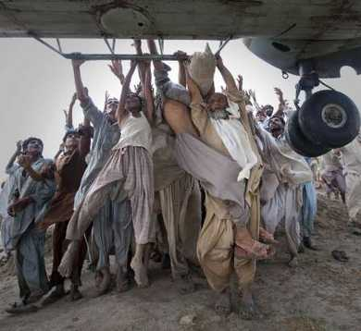
Don’t Expect Help
YOUR SURVIVAL DEPENDS ON YOUR PREPAREDNESS – NOT THE GOVERNMENTS

Slide 16
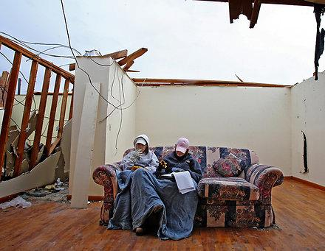
Are you ready?
When will the next disaster occur?
How big will it be?
Have you prepared for it?
Who will help you?
How long will it take for that help to arrive?
Would your family survive a severe disaster today?

Slide 17
BE READY!

Slide 18
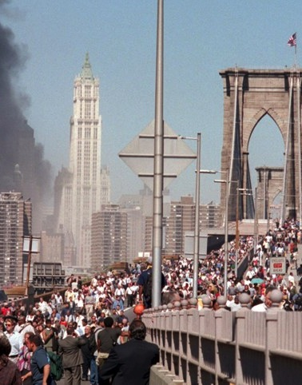
Be Ready!
Steps to preparedness
Be Aware
  Understand the threat
Make a Plan
  Have a detailed plan for you and your family to survive a disaster
Get a kit
  Obtain the supplies and equipment to survive

Slide 19
Be Aware

Slide 20
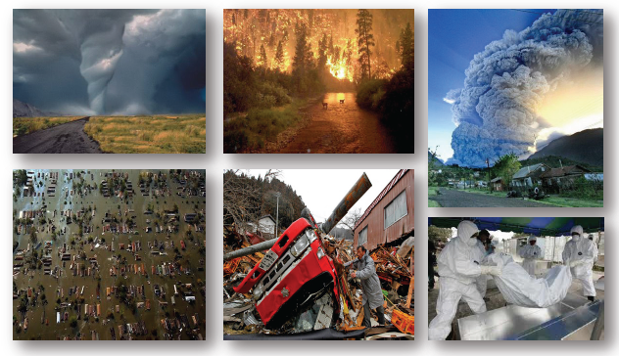
What is the definition of a disaster

Slide 21
What is the definition of a disaster
“A disaster is a non-routine event that exceeds the capacity of the affected area to respond to it in such a way as to save lives; to preserve property; and to maintain the social, ecological, economic, and political stability of the affected region.” (FEMA)
“A disaster is a serious disruption of the functioning of a society, causing widespread human, material or environmental losses which exceed the ability of the affected society to cope using only its own resources”
(UNDP)

Slide 22
Types of Disaster
Natural
Floods
Tornadoes
Hurricanes
Earthquakes
Volcanoes
Landslides
Tsunamis
Wildfire
Technological
Chemical
Nuclear
Biological
Fire
Infrastructure
Complex
Migration
Warfare
Terrorism
Genocide

Slide 23
Natural Disasters
Hydrogical
Geophysical
Biological
Meteorlogical
Climatological

Slide 24
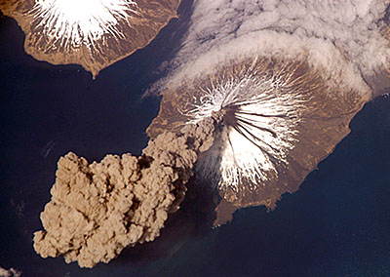
Is it a disaster if?
  If a Volcano erupts on an uninhabited island in the Pacific Ring and there is no significant environmental impact?
  If an Earthquake occurs in a prepared city in Japan and there are no casualties or and little damage?
  If a very large refugee population from Somalia occupies a small community in Kenya?

Slide 25
Impact
“Earthquakes don’t kill people, buildings do”
Hazard
Vulnerability
Capacity
Impact

Slide 26
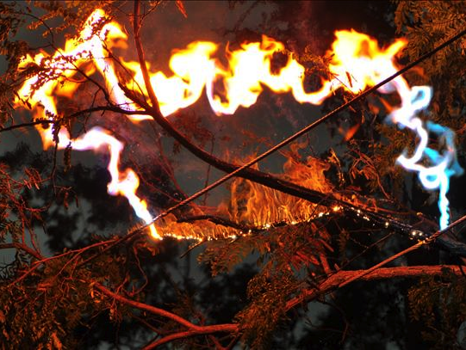
Impact
Service Disruption
Civil Protection & Medicals Systems
  EMS, Police, Fire, Hospital
Pipeline Services
  Sewage, water, gas, etc.
Electric Grid
  Unless solar panels/generator
Communications Systems
  Mobile, internet, TV, radio, telephone
Logistics/Transit
  Road, rail, air, mail, fuel, merchandise & food goods

Slide 27
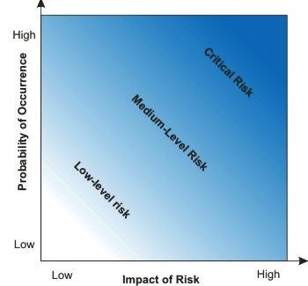
Risk Analysis
Risk Analysis
List hazards that exist in your community
Probability + Impact
Highest risk incidents have the greatest sum of Probability and Impact

Slide 28
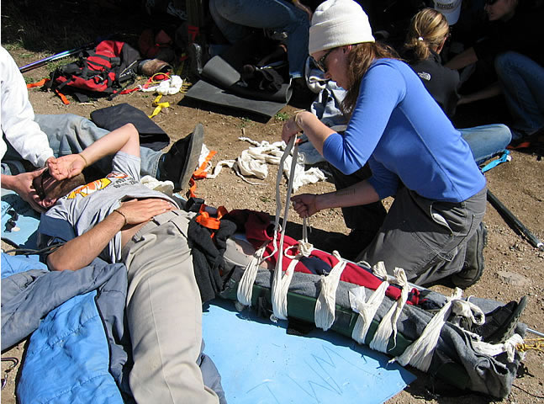
Disaster Risk Reduction
Vulnerability Reduction
Prevention - STOP
  Warfare/Structural Failure
Mitigation - REDUCE
  Early Warning/Building Codes/Deadfall/Sea Walls/Deforestation
Preparedness - REACT
  Go Bag / Plan
Notes:
The first bullet is key: if a responder puts himself in danger – he/she is likely to become part of the problem and NOT part of the solution.

Slide 29
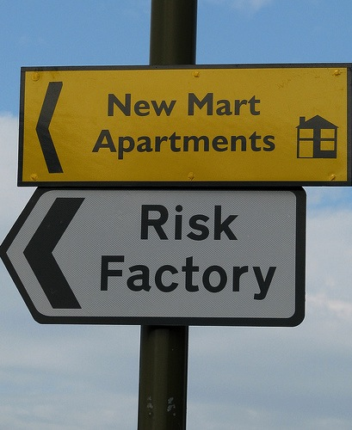
Risk Analysis
Disaster | Probability | Impact | Risk | Rank
Wild Fire
Blizzard
Tornado
Flood
Civil Unrest
Earthquake
Terrorism

Slide 30
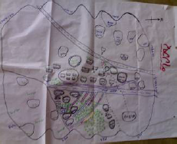
Risk Analysis
Hazard Mapping
What are the hazards?
What areas of the community are at risk?
What facilities are in danger?
Who are the people most exposed and will likely need assistance?
What resources can be found?
Who has access and control of the resources?
What resources are at risk?

Slide 31
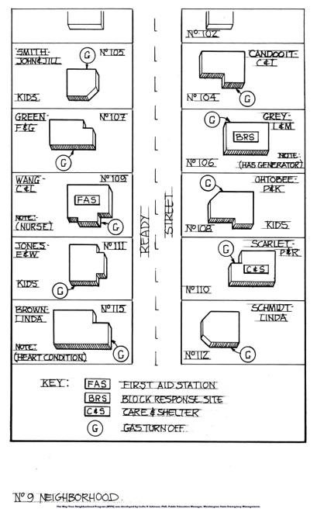
Risk Analysis
Hazard Mapping Method
Invite community to attend
Create a master map of the community (use Google earth)
  Streets
  Houses
  Facilities
  ** include names of neighbors on houses**

Slide 32
Risk Analysis

Slide 33
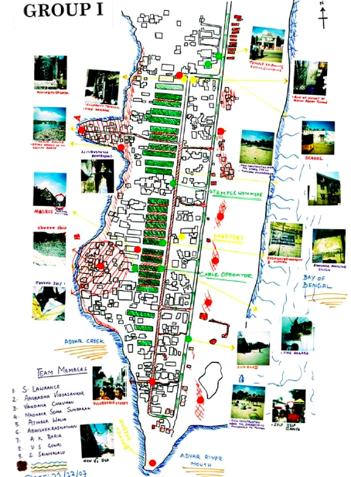
Risk Analysis

Slide 34
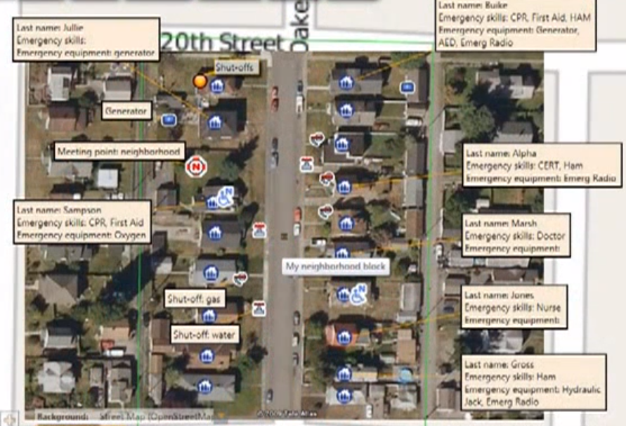
Risk Analysis

Slide 35
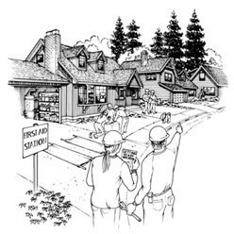
Risk Analysis
Hazard Mapping Method
Take key community members on a walk around the community
Verify Map Data
Take pictures
Confirm at risk areas/populations

Slide 36
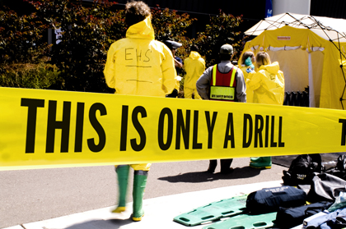
Activity – Hazard Map
Create a hazard map for your community utilizing the disaster the represented the greatest risk during your hazard analysis exercise. Remember to identify the following:
Areas that would be impacted
Populations that would be impacted
Usable resources, skills, and equipment
Critical Infrastructure

Slide 37
Be Aware
Emergency Warning Systems
Emergency Alert System (EAS)
NOAA Weather Radio (NWR)
Wireless Emergency Alerts (WEA)
City Emergency Radio (850 AM)
Sirens

Slide 38
Make A Plan

Slide 39
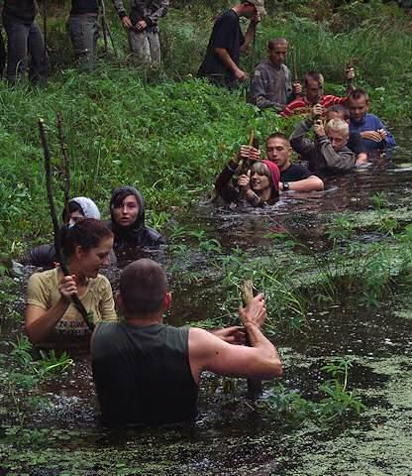
Disaster Mentality
Disaster Mindset
Theory of 10-80-10
  10% - Rational
  80% - Shock
  10% - Dangerous
We become Rational by having a plan
Notes:
10 percent of us will handle a crisis in a relatively calm and rational state of mind. Under duress these 10% pull themselves together quickly. They assess situations clearly. Their decision making is sharp and focused. They’re able to develop priorities, make plans, and take appropriate action. They tend to keep emotions in check so they can think and solve problems. Psychologists call this process “slitting” and it is common among people who keep their cool under the greatest stress.
Large majority of us fall into the 80%. IN a crisis most of us will be “stunned and bewildered. We’ll find that our “reasoning is significantly impaired and that thinking is difficult.” We’ll behave in “a reflexive, almost automatic or mechanical manner”. The 80% will feel lethargic and numb. We’ll sweat. We’ll feel sick. Our hearts will race and we’re experiencing “perceptual narrowing” or so-called tunnel vision. We’ll stare straight ahead. We will not hear people around us. We will lose sense and sight of what is going on around us. IN short most of us will turn into status in the first moments of a crisis. It’s okay – it’s not necessarily fatal – and it doesn’t last forever. The key is to recover quickly from brainlock or analysis paralysis, shake off the shock, and figure out what to do.
The last group – the final 10% is the one you want to avoid in an emergency or crisis. The members of the third band do the wrong thing. They behave inappropriately and often counterproductively. They make the situation worse. They’re the ones who lose control of themselves and freak out and cannot regain control of themselves.
Which are you in:
Actively surviving 10%
Statuesque 80%
Dangerous 10%
IN reality it is very hard to know what you will do. Even highly trained firefighters, police, medical personnel, and military sometimes freeze while children with no training glide through any situation.
How do you break out of the Statuesque 80%?

Slide 40
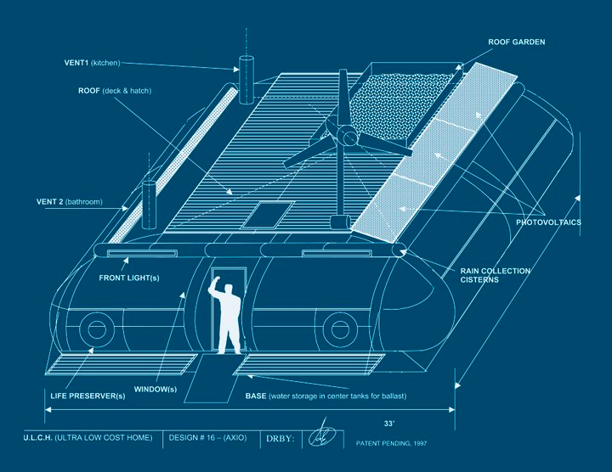
First Steps
Your Home - Mitigation
Locate and label all electrical panels
Locate and label gas line shut offs
Move lumber away from home
Trim trees and shrubs that might damage your home during a severe storm
Place heavy/breakable items on lower shelves
Replace any damaged electrical plugs, cords, or sockets
Install flexible pipe-fittings
Store flammable/hazardous chemicals/liquids in secure locations away from electrical outlets/wiring
Create a map of you home with exit points, fire extinguishers, first aid kits, and utility shut-off points

Slide 41
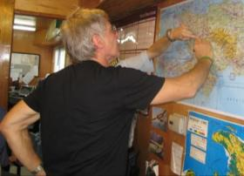
Family Preparedness Plan
Conduct a Disaster Risk Analysis
Determine how to react to each
Designate Consolidation Points
Designate a third party POC
Define roles and responsibilities
Mitigate potential hazards in your home
Train your family in basic life-saving techniques
Assemble a disaster kit and necessary supplies
Practice your plan
Notes:
These will all be outlined in the following slides.

Slide 42
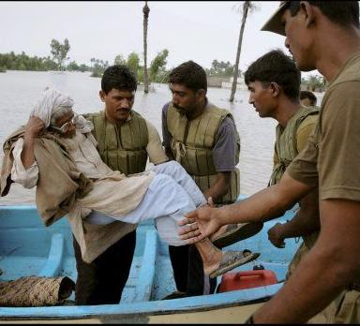
Family Preparedness Plan
Planning Considerations
  Hearing Impaired
  Mobility Impaired
  Single Working Parent
  People Without Vehicles
  Special Dietary Needs
  Children/Babies
  *Network assistance/warning
Notes:
If you or someone close to you has a disability or a special need, you may have to
take additional steps to protect yourself and your family in an emergency.
Hearing impaired May need to make special arrangements to receive
warnings.
Mobility impaired May need special assistance to get to a shelter.
Single working parent
May need help to plan for disasters and emergencies.
May need assistance planning for and responding to
emergencies. Community and cultural groups may be
able to help keep people informed.
People without vehicles
May need to make arrangements for transportation.
People with special dietary needs
Should take special precautions to have an adequate
emergency food supply.
Planning for Special Needs
If you have special needs:
• Find out about special assistance that may be available in your community.
Register with the ofﬁce of emergency services or the local ﬁ re department for
assistance so needed help can be provided. Are You Ready?
Basic
Preparedness
• Create a network of neighbors, relatives, friends, and coworkers to aid you
in an emergency. Discuss your needs and make sure everyone knows how to
operate necessary equipment.
• Discuss your needs with your employer.
• If you are mobility impaired and live or work in a high-rise building, have an
escape chair.
• If you live in an apartment building, ask the management to mark accessible
exits clearly and to make arrangements to help you leave the building.
• Keep specialized items ready, including extra wheelchair batteries, oxygen,
catheters, medication, food for service animals, and any other items you
might need.
• Be sure to make provisions for medications that require refrigeration.
• Keep a list of the type and model numbers of the medical devices you require.

Slide 43
EVAC/SIP

Slide 44
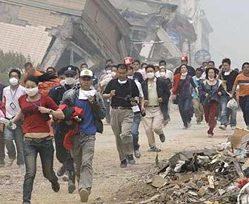
EVAC/SIP
Evacuation or Shelter in Place
Is evacuation possible?
Is there enough time to evacuate? How long will it take?
Is evacuating more dangerous than staying?
Can everybody be evacuated?
Is your home a safe place?
Has your shelter become compromised
** It is always best to stay**

Slide 45
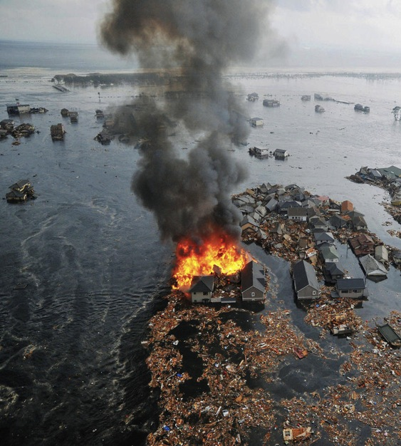
Evacuation
Home Evacuation
Prepare to evacuate your home have a plan to get out quickly and safely
Review escape routes with your family
Practice escaping from each room.
Make sure windows are not nailed, painted or barred shut.
Learn how to turn off the water, gas and electricity at main switches.
If your residence has more than one level, consider getting escape ladders.

Slide 46
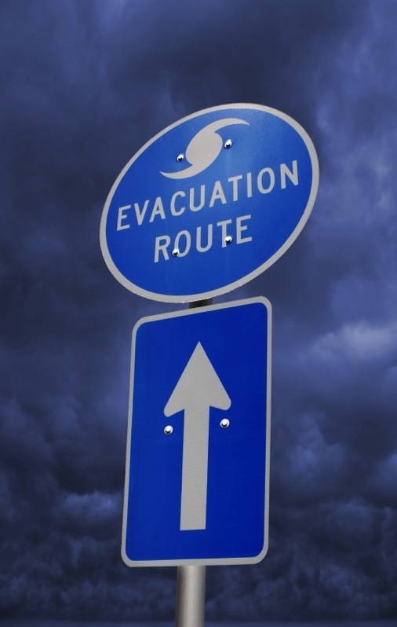
Evacuation
Escape
Identify ahead of time where your family will meet.
If you don’t have a car, plan alternate means of evacuating.
Always keep a half tank of fuel in your car.
If evacuation is likely, keep a full tank.
Plan several escape routes (secondary/tertiary)
Watch out for downed power lines and washed-out roads and bridges.
Leave a written message

Slide 47
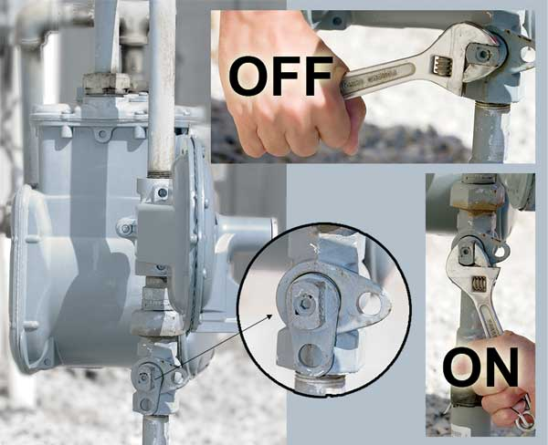

Slide 48
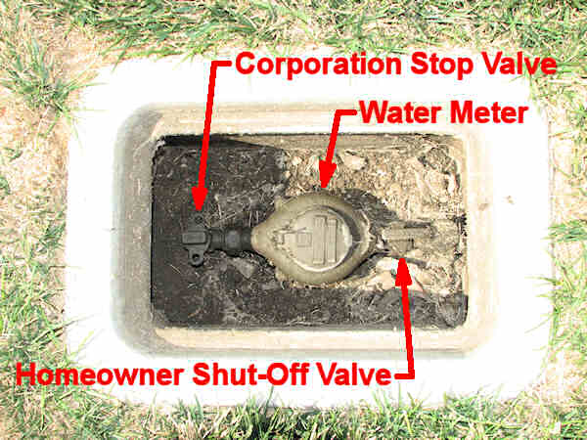

Slide 49
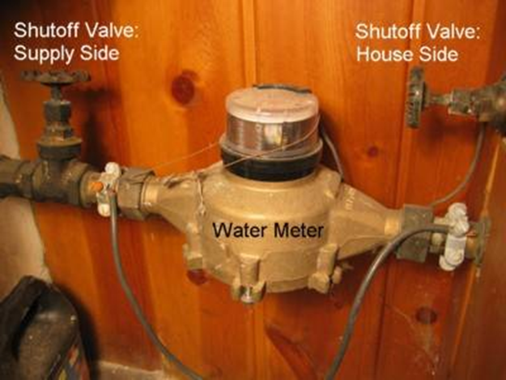

Slide 50
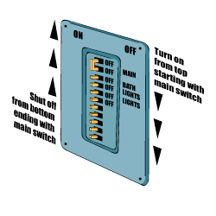

Slide 51
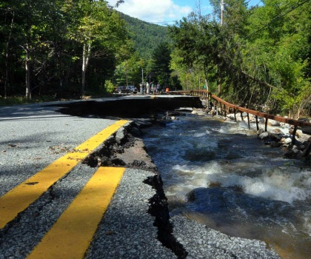
EVACUATION
Route Analysis
How many different routes are there?
Which threats exist for each route?
How much fuel/time will each route take?
Create maps for family members
Mark different routes with different colors
Designate routes based off time of day, season, and type of disaster.
CONSIDER TRAFFIC
Notes:
When community evacuations become necessary, local ofﬁcials provide information to the public through the media. In some circumstances, other warning
methods, such as sirens or telephone calls, also are used. Additionally, there may
be circumstances under which you and your family feel threatened or endangered
and you need to leave your home, school, or workplace to avoid these situations.
The amount of time you have to leave will depend on the hazard. If the event is
a weather condition, such as a hurricane that can be monitored, you might have
a day or two to get ready. However, many disasters allow no time for people to
gather even the most basic necessities, which is why planning ahead is essential.
In addition to ﬁnding out about your community’s plan, it is important that you
know what plans are in place for your workplace and your children’s school or day
care center.
1. Ask your employer about workplace policies regarding disasters and emergencies, including understanding how you will be provided emergency and
warning information.
2. Contact your children’s school or day care center to discuss their disaster procedures.
School Emergency Plans
Know your children’s school emergency plan:
• Ask how the school will communicate with families during a crisis.
• Ask if the school stores adequate food, water, and other basic supplies.
• Find out if the school is prepared to shelter-in-place if need be, and where
they plan to go if they must get away.
In cases where schools institute procedures to shelter-in-place, you may not be
permitted to drive to the school to pick up your children. Even if you go to the
school, the doors will likely be locked to keep your children safe. Monitor local
media outlets for announcements about changes in school openings and closings,
and follow the directions of local emergency ofﬁ cials.
For more information on developing emergency preparedness plans for schools,
please log on to the U.S. Department of Education at www.ed.gov/emergencyplan

Slide 52
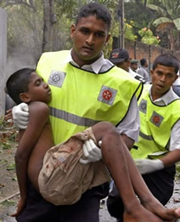
First Aid
First Aid Training
  Basic First Aid
  Cardio-Pulmonary Resuscitation
  Certified First Responder 40 hrs
  Wilderness First Aid
  Disaster Triage
  Child/Infant CPR
  AED Course

Slide 53
Have a Plan
First Aid
Responders are a limited asset
  Triage
  Responders as commodities
Scene Safety: Never put Yourself in Danger
  Scene Safety
  Disease Vectors
Notes:
The first bullet is key: if a responder puts himself in danger – he/she is likely to become part of the problem and NOT part of the solution.

Slide 54
EMT Dave’s Recommended Disaster First Aid Kit
• The Disaster First Aid Handbook
• Triage Tags or Tapes / marking pens
• Latex or vinyl gloves, 20 to 30 pairs
• Cloth advesive tapes 1” and 2” wide (2or 3 rolls)
• Plastic advesive tapes 1” and 2” wide (2or 3 rolls)
• Large & Medium sterile gauze pads 4x4 and 8x10
• Extra-Large band-aids 2”x4” or larger
• Quick Clot 3 packages
• Israeli Pressure Dressing
• Large packages (100 non-sterile 4"x4”gauze) (2 or 3 pkgs)
• Roller bandages Kling /Kerlix, or make your own (12 to 25)
• Triangle “cravat” slings, or make your own (several)
• Lots of extra-large safety pins
• Mild disinfectant (“Green Soap” or Betadine scrub)
• Hydrogen Peroxide (to use, dilute with water 50/50)
• Antibiotic ointment (Polysporin, Bacitracin)
• Sterile water or sterile Normal Saline
• Large waterproof Magic Marker
• First Report & Second Report forms (in the book)
• Small tablet or clipboard and pens
• Plastic baggies and heavy garbage bags
• Plastic sheeting ground cover 12x25 ft roll
• Mylar “space blankets” (6-12 or more)
• Clothesline-type rope or sash-cord
• “Duck” Tape (good for everything)
• Blunt-ended or “EMT” scissors 2 or 3 pairs
• Kitchen rubber gloves for general mess
• Pocket knife or folding lock-blade knife
• Consider a clean plastic spray or squirt bottle
• Keep 2 weeks supply of needed prescription medications you or your family usually take. If Diabetic include medicine & snack foods for them.
• Aspirin for FEVER/HEART ISSUES
• Anti-Diarrhea medicine
• Clean water
• CPR Mask
• Instant Cold Compress
• Super Glue

Slide 55
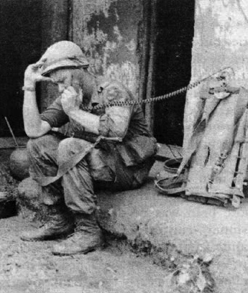
Communications Plan
Family Communication
  Prepaid phone cards
  Pictures
  Contact Cards
  Pre-arranged authorization
  Consolidation Points
  Third Party POCs
  Note Locations
Notes:
Your family may not be together when disaster strikes, so plan how you will con- tact one another. Think about how you will communicate in different situations.
Complete a contact card for each family member. Have family members keep these cards handy in a wallet, purse, backpack, etc. You may want to send one to school with each child to keep on file. Pick a friend or relative who lives out-of-state for household members to notify they are safe.
It is essential for household members to develop a plan for reuniting after a disaster. To prepare for a fire in the home, the family should identify a neighborhood rendezvous point located a safe distance from the house. If household members meet at the same spot, firefighters do not unnecessarily risk their lives trying to rescue someone who is
already safe. This place must be designated in advance. All family members must be directed to evacuate to this designated location in the event of a fire and not to go back into a burning building.
For an emergency that occurs when family members are not at the same location, an out-of- state friend or relative should be asked
to be the “family contact.” Even when local telephone service is disrupted, long distance service often works. After a disaster, separated family members should call the family contact to let him or her know where they are. It is important to make sure everyone knows the contact’s phone number.
It is also wise to know what disaster plans have been made by the children’s school or day care center and where children will be sent if they are in school when an evacuation is announced. Family members should also be aware of disaster plans for places where family members work. Knowing these plans can help them find each other more easily. In case parents should become separated from their children during a disaster, they may wish to consult the doctor in advance and file a Medical Release Form to ensure that any injuries sustained by the children in a disaster would be treated promptly.

Slide 56
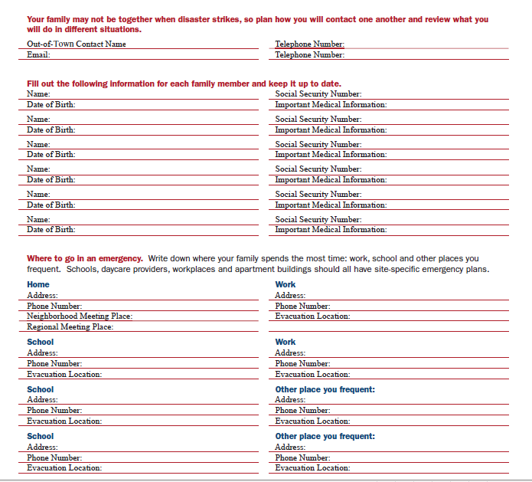
Notes:
Your family may not be together when disaster strikes, so plan how you will con- tact one another. Think about how you will communicate in different situations.
Complete a contact card for each family member. Have family members keep these cards handy in a wallet, purse, backpack, etc. You may want to send one to school with each child to keep on file. Pick a friend or relative who lives out-of-state for household members to notify they are safe.
It is essential for household members to develop a plan for reuniting after a disaster. To prepare for a fire in the home, the family should identify a neighborhood rendezvous point located a safe distance from the house. If household members meet at the same spot, firefighters do not unnecessarily risk their lives trying to rescue someone who is
already safe. This place must be designated in advance. All family members must be directed to evacuate to this designated location in the event of a fire and not to go back into a burning building.
For an emergency that occurs when family members are not at the same location, an out-of- state friend or relative should be asked
to be the “family contact.” Even when local telephone service is disrupted, long distance service often works. After a disaster, separated family members should call the family contact to let him or her know where they are. It is important to make sure everyone knows the contact’s phone number.
It is also wise to know what disaster plans have been made by the children’s school or day care center and where children will be sent if they are in school when an evacuation is announced. Family members should also be aware of disaster plans for places where family members work. Knowing these plans can help them find each other more easily. In case parents should become separated from their children during a disaster, they may wish to consult the doctor in advance and file a Medical Release Form to ensure that any injuries sustained by the children in a disaster would be treated promptly.

Slide 57
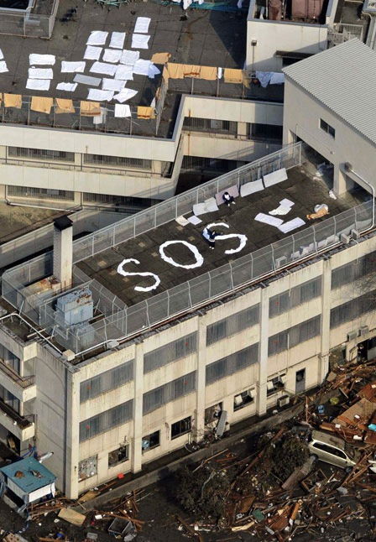
Communications Plan
Communicate
Radio:
  Amateur Radio (HAM RADIO)
  Handheld
  Crank Radio
  Satellite Communications
Mobile/SMS
Non-Electronic
  Flares/flashlights
  Whistle
  Mirrors
  Smoke
  Written (SOS in rocks)
Notes:
Cell phone services quickly become inundated and overwhelmed. It is nearly impossible to place a call during a disaster, even if the infrastructure is intact.
Amateur Radio does not require third parties – encourage getting licensed
Satellite Phones are convenient but expensive – they too can be overwhelmed
Text will sometimes go through when calls will not

Slide 58

Communications Plan
Family Communication
  Consolidation Point
    Outside home – 100m
    Local – 5-10 miles away
    Regional – 50-75 miles away
    SHTF – x > 180 miles away
    Different Locations for different disasters
    ****Redundancy****
Notes:
Your family may not be together when disaster strikes, so plan how you will con- tact one another. Think about how you will communicate in different situations.
Complete a contact card for each family member. Have family members keep these cards handy in a wallet, purse, backpack, etc. You may want to send one to school with each child to keep on file. Pick a friend or relative who lives out-of-state for household members to notify they are safe.
It is essential for household members to develop a plan for reuniting after a disaster. To prepare for a fire in the home, the family should identify a neighborhood rendezvous point located a safe distance from the house. If household members meet at the same spot, firefighters do not unnecessarily risk their lives trying to rescue someone who is
already safe. This place must be designated in advance. All family members must be directed to evacuate to this designated location in the event of a fire and not to go back into a burning building.
For an emergency that occurs when family members are not at the same location, an out-of- state friend or relative should be asked
to be the “family contact.” Even when local telephone service is disrupted, long distance service often works. After a disaster, separated family members should call the family contact to let him or her know where they are. It is important to make sure everyone knows the contact’s phone number.
It is also wise to know what disaster plans have been made by the children’s school or day care center and where children will be sent if they are in school when an evacuation is announced. Family members should also be aware of disaster plans for places where family members work. Knowing these plans can help them find each other more easily. In case parents should become separated from their children during a disaster, they may wish to consult the doctor in advance and file a Medical Release Form to ensure that any injuries sustained by the children in a disaster would be treated promptly.

Slide 59
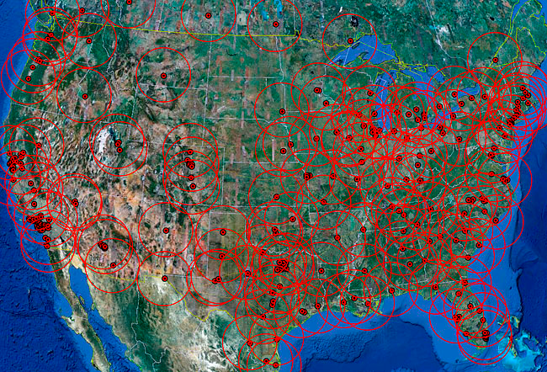
Notes:
While determining an ideal location for a survival retreat or bug-out-location, a location that perhaps you will use as a vacation spot / insurance policy, or maybe a location where you will live full time, you should consider the distance from a dense population area or city. In the event of a terrible disaster, there will be hordes of people trying to escape the city centers which will have become very dangerous from the lack of working infrastructure, food, water, and fuel.
Determine how far the roving hordes will get during their desperate escape from the city
The average fuel economy (miles per gallon) of a vehicle varies of course, depending on factors including vehicle and engine size, its vintage, and whether city or highway driving. In the U.S. the current 2010 ‘CAFE’ standard for new passenger vehicles is 27.5 mpg and 23.5 mpg for light trucks (GVWR less than 8,500 pounds). Not everyone has a new car. A number of years ago a study was performed that determined 60 percent of vehicles in the U.S. were older than seven years. 10 years ago the standards were 27.5 and 20.7 mpg. For the sake of determining the average fuel economy of all vehicles on the road today, factoring in highway and city mileage, my instinct tells me it may be somewhere around 20 miles per gallon, maybe slightly less. Lets use 20 mpg for this example.
The average fuel tank size of passenger vehicles, SUV’s, and trucks range in size from 10-13 gallons for compact-size, 15-18 gallons for mid-size, 18-20 for full-size, to as high as 30 gallons for large vehicles and trucks. I believe that the average fuel tanks size of all vehicles on the road today is probably about 18 gallons.
Although your vehicle may vary from this average (plug in your own numbers), the average maximum range of all vehicles on the road at any given moment based on a full tank of gas is probably about 360 miles (20 mpg x 18 gallons). Problem is, not everyone has a full tank of gas at all times and in fact, many people don’t add fuel until the tank is fairly low (and many people don’t fill the tank at that point either). Averaging all vehicles on the road, I believe that the amount of fuel in the tank at any one time is probably less than half a tank (I would bet one-third of a tank), but for this exercise lets use half a tank. This then changes the average maximum range of all vehicles on the road at any given time to be about 180 miles.
When the hordes evacuate the cities, at best, on average, most won’t get beyond 180 miles. In fact, the average range will be less than that because most people will leave too late and will be caught in slow traffic. The traffic will quickly become heavy and the highways may even become impassible. Just imagine the scenario of heavy traffic, then factor in the vehicles that begin running out of gas which will further clog the highways. People will be getting off exits in search of fuel, which may not be available at all. If there is no electrical power, the fuel cannot be pumped. Even with power, gas stations will run dry quickly. Most people will not have thought about carrying extra fuel.

Slide 60
Get A Kit

Slide 61
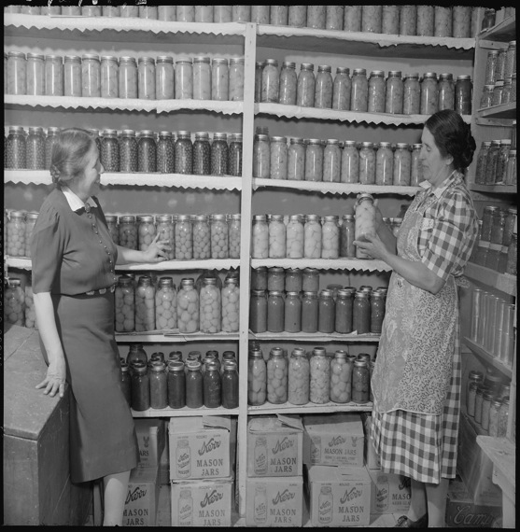
Get a Kit
Two Types of Supplies
    Shelter in Place
      What you will need if you remain at your home of bug-out site
    Evacuation
      What you will need to get to your bug-out site/home
Notes:
When community evacuations become necessary, local ofﬁcials provide information to the public through the media. In some circumstances, other warning
methods, such as sirens or telephone calls, also are used. Additionally, there may
be circumstances under which you and your family feel threatened or endangered
and you need to leave your home, school, or workplace to avoid these situations.
The amount of time you have to leave will depend on the hazard. If the event is
a weather condition, such as a hurricane that can be monitored, you might have
a day or two to get ready. However, many disasters allow no time for people to
gather even the most basic necessities, which is why planning ahead is essential.
In addition to ﬁnding out about your community’s plan, it is important that you
know what plans are in place for your workplace and your children’s school or day
care center.
1. Ask your employer about workplace policies regarding disasters and emergencies, including understanding how you will be provided emergency and
warning information.
2. Contact your children’s school or day care center to discuss their disaster procedures.
School Emergency Plans
Know your children’s school emergency plan:
• Ask how the school will communicate with families during a crisis.
• Ask if the school stores adequate food, water, and other basic supplies.
• Find out if the school is prepared to shelter-in-place if need be, and where
they plan to go if they must get away.
In cases where schools institute procedures to shelter-in-place, you may not be
permitted to drive to the school to pick up your children. Even if you go to the
school, the doors will likely be locked to keep your children safe. Monitor local
media outlets for announcements about changes in school openings and closings,
and follow the directions of local emergency ofﬁ cials.
For more information on developing emergency preparedness plans for schools,
please log on to the U.S. Department of Education at www.ed.gov/emergencyplan

Slide 62
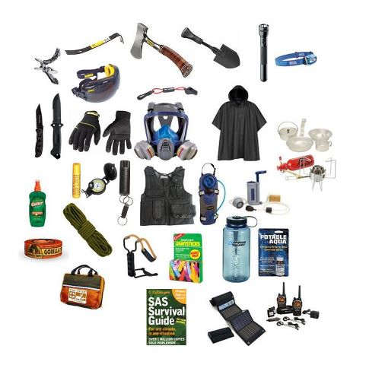
Evacuation Kit
Go Bag
  You will need to leave very quickly and survive
  It may take days to find safety/rescue
  What would “pre-pack” to survive in a harsh disaster zone while on the move?
    Sustenance Needs
    Survival Tools and Assets
    ** Consider your pets!!**
Notes:
When community evacuations become necessary, local ofﬁcials provide information to the public through the media. In some circumstances, other warning
methods, such as sirens or telephone calls, also are used. Additionally, there may
be circumstances under which you and your family feel threatened or endangered
and you need to leave your home, school, or workplace to avoid these situations.
The amount of time you have to leave will depend on the hazard. If the event is
a weather condition, such as a hurricane that can be monitored, you might have
a day or two to get ready. However, many disasters allow no time for people to
gather even the most basic necessities, which is why planning ahead is essential.
In addition to ﬁnding out about your community’s plan, it is important that you
know what plans are in place for your workplace and your children’s school or day
care center.
1. Ask your employer about workplace policies regarding disasters and emergencies, including understanding how you will be provided emergency and
warning information.
2. Contact your children’s school or day care center to discuss their disaster procedures.
School Emergency Plans
Know your children’s school emergency plan:
• Ask how the school will communicate with families during a crisis.
• Ask if the school stores adequate food, water, and other basic supplies.
• Find out if the school is prepared to shelter-in-place if need be, and where
they plan to go if they must get away.
In cases where schools institute procedures to shelter-in-place, you may not be
permitted to drive to the school to pick up your children. Even if you go to the
school, the doors will likely be locked to keep your children safe. Monitor local
media outlets for announcements about changes in school openings and closings,
and follow the directions of local emergency ofﬁ cials.
For more information on developing emergency preparedness plans for schools,
please log on to the U.S. Department of Education at www.ed.gov/emergencyplan

Slide 63
Activity – Go Bag
An X-18 class solar flare has just struck the US. The power grid has been disabled. All communications are inoperable and your vehicle will no longer start. You are with you family and you decide it is much safer to evacuate Denver area and move by foot to the foothills. What would be in your Go-Bag? Consider weight.

Slide 64
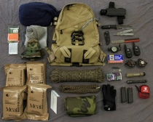
Evacuation Kit
Go Bag
Water & Purification
Non-Perishable Food
Clothing
Rain Gear
Sleeping Bag/Space Blanket
Contact Info
Headlamp/Torch/Candle
Fire Starter & Tinder
Map /GPS/Compass
Extra Medications
Tape
Multipurpose Tool
Whistle/Mirror
Cash/Credit Card
Hand Sanitizer
Fishing Line/Hook/Traps
Documentation
Photos of Family
Radios
Work Gloves
Cordage (550 Cord/Para-cord)
First Aid Kit
Insect Repellent/Net
Tarp/Shelter
Baby Food/Diapers
Hygiene Kit
Batteries
Phone Credits
Water Container
Notes:
You may need to survive on your own after a disaster. This means having your
own food, water, and other supplies in sufﬁcient quantity to last for at least three
days. Local ofﬁcials and relief workers will be on the scene after a disaster, but they
cannot reach everyone immediately. You could get help in hours, or it might take
days.
Basic services such as electricity, gas, water, sewage treatment, and telephones may
be cut off for days, or even a week or longer. Or, you may have to evacuate at a
moment’s notice and take essentials with you. You probably will not have the opportunity to shop or search for the supplies you need.
A disaster supplies kit is a collection of basic items that members of a household
may need in the event of a disaster
The following items are recommended for inclusion in your basic go-bag
kit:
• Three-day supply of non-perishable food.
• Three-day supply of water – one gallon of water per person, per day.
• Portable, battery-powered radio or television and extra batteries.
• Flashlight and extra batteries.
• First aid kit and manual.
• Sanitation and hygiene items (moist towelettes and toilet paper).
• Matches and waterproof container.
• Whistle.
• Extra clothing.
• Kitchen accessories and cooking utensils, including a can opener.
• Photocopies of credit and identiﬁcation cards.
• Cash and coins.
• Special needs items, such as prescription medications, eye glasses, contact lens
solutions, and hearing aid batteries.
• Items for infants, such as formula, diapers, bottles, and paciﬁers.
• Other items to meet your unique family needs.
If you live in a cold climate, you must think about warmth. It is possible that you
will not have heat. Think about your clothing and bedding supplies. Be sure to
include one complete change of clothing and shoes per person, including:
• Jacket or coat.
• Long pants.
• Long sleeve shirt.
• Sturdy shoes.
• Hat, mittens, and scarf.
• Sleeping bag or warm blanket (per person).
Be sure to account for growing children and other family changes. See Appendix B
for a detailed checklist of disaster supplies. You may want to add some of the items
listed to your basic disaster supplies kit depending on the speciﬁc needs of your
family

Slide 65
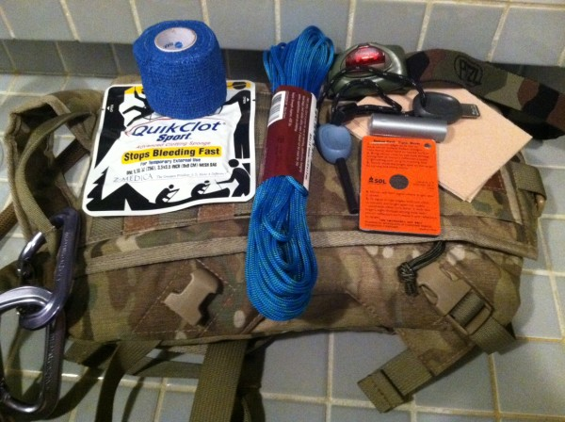
Evacuation Kit
Individual Kit
Stays with you at all times.. In your briefcase, backpack, purse, etc.
  Electrical Tape
  Quick clot & bandage
  550 para cord
  Lighter/Small canister of tender
  Survival Signal Mirror
  Compass
  Head lamp
  Multi-tool
  Cliff Bar/Water
  Cash
  Space blanket/poncho

Slide 66
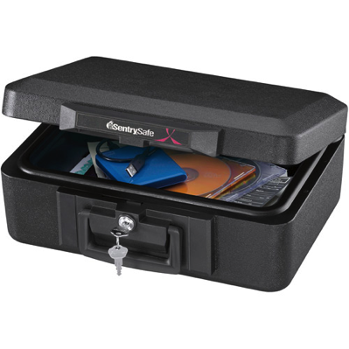
Documentation
Photocopies in several locations
Scans on a protected Hard Drive
Originals in a fire-proof Safe
Data backed up to a cloud and hard Drive
Birth certificate
Marriage certificate
Driver's license
Social Security cards
Passports
Wills
Deeds
Inventory of household goods
Insurance papers
Immunization records
Bank and credit card account numbers
Stocks and bonds
Emergency contact list and phone numbers

Slide 67
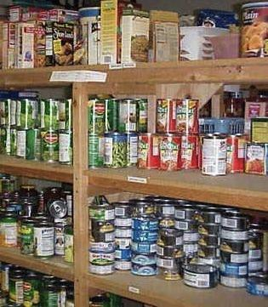
SIP Kit
Supplies
Food, Water, Medication, Hygiene, Fuel, etc..
  Home
    3 Weeks to 6 Months
  Work
    1-2 Days
  Car
    1-3 Days
    **Tip: Keep your Go-Bag in your car**
Notes:
A person can have a massive stockpile of supplies at his/her home, but if a disaster or emergency occurs while they are at work or in their car, their home-supplies will be useless.
Just as important as putting your supplies together is maintaining them so they are
safe to use when needed. Here are some tips to keep your supplies ready and in
good condition:
• Keep canned foods in a dry place where the temperature is cool.
• Store boxed food in tightly closed plastic or metal containers to protect from
pests and to extend its shelf life.
• Throw out any canned good that becomes swollen, dented, or corroded.
• Use foods before they go bad, and replace them with fresh supplies.
• Place new items at the back of the storage area and older ones in the front.
• Change stored food and water supplies every six months. Be sure to write the
date you store it on all containers.
• Re-think your needs every year and update your kit as your family needs
change.
• Keep items in airtight plastic bags and put your entire disaster supplies kit in
one or two easy-to-carry containers, such as an unused trashcan, camping
backpack, or duffel bag

Slide 68
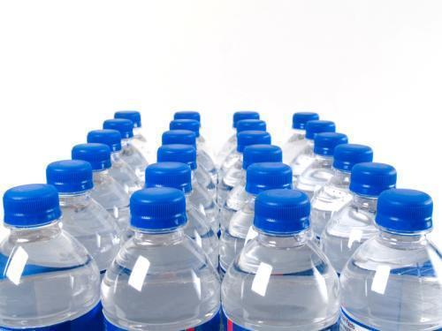
SIP Kit
Water Supplies
1 Gallon Per Person/Day
What increases use?
  Physical Activity
  Hot climate
  Nursing mothers
  The sick and ill
  Medical emergencies
Notes:
Water:
Your body loses water through normal body processes (sweating, urinating, and defecating). During average daily exertion when the atmospheric temperature is 20 degrees Celsius (C) (68 degrees Fahrenheit), the average adult loses, and therefore requires, 2 to 3 liters of water to replace what is lost daily. Other factors, such as heat exposure, cold exposure, intense
activity, high altitude, burns, or illness, can cause your body to lose more water. You must replace this water.
Dehydration results from inadequate replacement of lost body fluids. It decreases your efficiency and, if injured, increases your susceptibility to
severe shock.
Consider the following results of body fluid loss:
A 5 percent loss of body fluids results in thirst, irritability, nausea, and weakness.
A 10 percent loss results in dizziness, headache, inability to walk, and a tingling sensation in the limbs.
A 15 percent loss results in dim vision, painful urination, swollen tongue, deafness, and a numb feeling in the skin.
A loss greater than 15 percent of body fluids may result in death.
The most common signs and symptoms of dehydration are—
Dark urine with a very strong odor.
Low urine output.
Dark, sunken eyes.
Fatigue.
Emotional instability.
4-2Loss of skin elasticity.
Delayed capillary refill in fingernail beds.
Trench line down center of tongue.
Thirst. - Last on the list because you are already 2% dehydrated by the time you crave fluids.

Slide 69
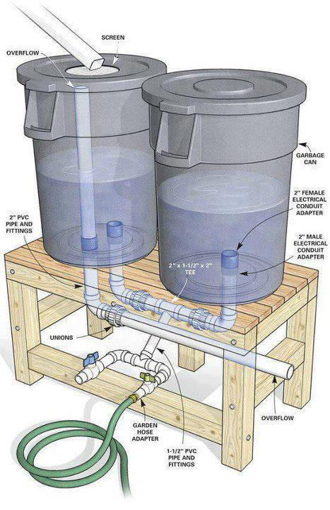
SIP Kit
Water Storage
Add 1-2 small drops of bleach per liter before storing
Containers
  Use food-grade plastic
  Do not use Juice/Milk containers
Replace stored water containers every 6 months
Fill tubs/sinks/etc before a disaster
Remember alternate sources
Consider a catchment system
Notes:
Milk and Juice leave microscopic organic particles that bond to plastic. These particles can quickly contaminate clean water and cause the growth of mold and other harmful micro organisms. It is nearly impossible to completely sterilize a container, so two drops of bleach per gallon is necessary. This will prevent micro-organism growth but will not harm the body. Just to be safe – replace water every 6 months.
How Should I Store Water?
To prepare safest and most reliable emergency supply of water, it is recommended
you purchase commercially bottled water. Keep bottled water in its original container and do not open it until you need to use it.
Observe the expiration or “use by” date.
If you are preparing your own
containers of water
It is recommended you purchase food-grade water storage containers from surplus or camping supplies stores to use for water storage. Before ﬁ lling with water,
thoroughly clean the containers with dishwashing soap and water, and rinse completely so there is no residual soap. Follow directions below on ﬁ lling the container
with water.
If you choose to use your own storage containers, choose two-liter plastic soft
drink bottles – not plastic jugs or cardboard containers that have had milk or fruit
juice in them. Milk protein and fruit sugars cannot be adequately removed from
these containers and provide an environment for bacterial growth when water
is stored in them. Cardboard containers also leak easily and are not designed for
long-term storage of liquids. Also, do not use glass containers, because they can
break and are heavy.
If storing water in plastic soda
bottles, follow these steps
Thoroughly clean the bottles with dishwashing soap and water, and rinse completely so there is no residual soap.
Sanitize the bottles by adding a solution of 1 teaspoon of non-scented liquid
household chlorine bleach to a quart of water. Swish the sanitizing solution in the
bottle so that it touches all surfaces. After sanitizing the bottle, thoroughly rinse out
the sanitizing solution with clean water.
Fill the bottle to the top with regular tap water. If the tap water has been commercially treated from a water utility with chlorine, you do not need to add anything
else to the water to keep it clean. If the water you are using comes from a well or
water source that is not treated with chlorine, add two drops of non-scented liquid
household chlorine bleach to the water.
Tightly close the container using the original cap. Be careful not to contaminate the
cap by touching the inside of it with your ﬁ nger. Place a date on the outside of the
container so that you know when you ﬁ lled it. Store in a cool, dark place.
Replace the water every six months if not using commercially bottled wate

Slide 70

SIP Kit
Food Supplies
Non-perishable
Proteins & Starches
Avoid High Salts
Vitamins/minerals
Requirements for preparation
Notes:
The body needs both proteins and starches to survive. Often times proteins are ignored. Protein is need to repair and make new cells. Without protein this is not possible. If you don't eat enough proteins you get hungrier sooner.
Read more: http://wiki.answers.com/Q/What_happens_without_protein#ixzz19RJqMoMH
Excess salt causes the body to retain water and also causes dehydration. Kind of sounds contradictory, but this is how the body works. This in turn leads to high blood pressure. Excess salt is one of the primary causes of hypertension. In an environment where clean water is scarce, salt can be deadly.

Slide 71
Activity
You have decided to store 3 weeks of food in your basement at your home. What types of food items will you purchase and store?

Slide 72

SIP Kit
Food Supplies
Tuna
Instant Soup
Beans
Canned Vegetables
Canned Fruits
Nuts
Crackers
Peanut Butter
Granola Bars
Honey
Cereal
Baby Formula/Food
Energy Bars
Canned Chicken
Jelly
Canned Juice
Powdered Milk
Instant Coffee
Camping Meals
Salt
Notes:
Ideal foods do not require much additional water or heating to prepare. Water and heating fuel are scarce in a disaster.

Slide 73

SIP Kit
Food Preparation
Cooking:
  Charcoal Grills
  Camp Stoves
  Fireplace
  Candle Warmers
  Home-made stove
  Solar Oven
  Fondue Set (alcohol burning)
Eating
  CAN OPENER
  “Canteen cup”
  Camp cookware
Notes:
Alternative cooking sources in times of emergency include candle warmers,
chaﬁng dishes, fondue pots, or a ﬁreplace.
• Charcoal grills and camp stoves are for outdoor use only.
• Commercially canned food may be eaten out of the can without warming.
• To heat food in a can:
1. Remove the label.
2. Thoroughly wash and disinfect the can. (Use a diluted solution of one part
bleach to ten parts water.)
3. Open the can before heating.

Slide 74

SIP Kit
Hygiene
Toilet (separate solid/liquid):
  5 Gallon Bucket with Lid
  Trash bags
  Place to burn or bury waste
  1lb Chlorinated Lime per person/week
Shower
  Camp Shower
  Wet wipes/ Waterless shampoo
Hygiene
  Hand Sanitizer
  Body powder
  Plenty of bleach
Notes:
Alternative cooking sources in times of emergency include candle warmers,
chaﬁng dishes, fondue pots, or a ﬁreplace.
• Charcoal grills and camp stoves are for outdoor use only.
• Commercially canned food may be eaten out of the can without warming.
• To heat food in a can:
1. Remove the label.
2. Thoroughly wash and disinfect the can. (Use a diluted solution of one part
bleach to ten parts water.)
3. Open the can before heating.

Slide 75

SIP Kit
Power/Light
Power
  Generator
  Solar Panels
  Crank Devices
      Radios
      Flashlights
      Cell Phone Chargers
  Wind Energy
Light
  Candles
  Glow sticks
  Kerosene Lamps
Notes:
Alternative cooking sources in times of emergency include candle warmers,
chaﬁng dishes, fondue pots, or a ﬁreplace.
• Charcoal grills and camp stoves are for outdoor use only.
• Commercially canned food may be eaten out of the can without warming.
• To heat food in a can:
1. Remove the label.
2. Thoroughly wash and disinfect the can. (Use a diluted solution of one part
bleach to ten parts water.)
3. Open the can before heating.

Slide 76
Survival

Slide 77

Basic Survival Needs
Traits of a Survivor
Don’t Overreact – Maintain Control
Get in Shape – You’ll go further, faster, longer.
Rely on good data - not emotion
Positive Outlook

Slide 78

Basic Survival Needs
COMMUNITY!!!
Know your neighbors!
  Security
  Assistance
What skills and expertise can benefit you team?
What responsibilities can be delegated/assigned?
What resources can be shared?
Who do you know and trust?

Slide 79

Basic Survival Needs
Rule of Threes
You may only survive 3 seconds without a plan
You can survive 3 minutes without oxygen
You can survive 3 hours without shelter
You can survive 3 days without water
You can survive 3 weeks without food

Slide 80
Basic Survival Needs
Basic Needs
Security
Water
Shelter
Food

Slide 81

Basic Survival Needs
Home Security
  Solid metal or wood doors/dead bolts on all exterior
  Consider an inside mounted door bar
  “Beware of Dog” sign even if you just have a cat or goldfish.
  Upgraded door hardware with deep-set 3” screws.
  Exterior motion lights (solar-powered) – front and back.
  ‘Defensive’ thorn bushes below each ground-level window.
  Upgraded window locks / cut wood-block stoppers for inside.
  Well-advertised video alarm system – whether you have one or not.

Slide 82

Basic Survival Needs
Tools/Training
  Weapons
    Stun Guns
    Pepper Spray
    Fire-arms
  Training
    Physically Fit
    Self-Defense

Slide 83

Basic Survival Needs
Water Purification
Types of Contamination
Particulate Contamination
Microbial Contamination
Chemical Contamination
Notes:
Treat all water of uncertain quality before using it for drinking, food washing or
preparation, washing dishes, brushing teeth, or making ice. In addition to having
a bad odor and taste, contaminated water can contain microorganisms (germs) that
cause diseases such as dysentery, cholera, typhoid, and hepatitis.
There are many ways to treat water. None is perfect. Often the best solution is a
combination of methods. Before treating, let any suspended particles settle to the
bottom or strain them through coffee ﬁ lters or layers of clean cloth.
Make sure you have the necessary materials in your disaster supplies kit for the chosen water treatment method.
There are three water treatment methods. They are as follows:
• Boiling
• Chlorination
• Distillation
These instructions are for treating water of uncertain quality in an emergency situation, when no other reliable clean water source is available, or you have used all of
your stored water.
Boiling
Boiling is the safest method of treating water. In a large pot or kettle, bring water
to a rolling boil for 1 full minute, keeping in mind that some water will evaporate. Let the water cool before drinking.
Boiled water will taste better if you put oxygen back into it by pouring the water
back and forth between two clean containers. This also will improve the taste of
stored water.
Chlorination
You can use household liquid bleach to kill microorganisms. Use only regular
household liquid bleach that contains 5.25 to 6.0 percent sodium hypochlorite.
Do not use scented bleaches, color safe bleaches, or bleaches with added cleaners.
Because the potency of bleach diminishes with time, use bleach from a newly
opened or unopened bottle.
Add 16 drops (1/8 teaspoon) of bleach per gallon of water, stir, and let stand for
30 minutes. The water should have a slight bleach odor. If it doesn’t, then repeat
the dosage and let stand another 15 minutes. If it still does not smell of chlorine,
discard it and ﬁ nd another source of water.
Other chemicals, such as iodine or water treatment products sold in camping or
surplus stores that do not contain 5.25 to 6.0 percent sodium hypochlorite as the
only active ingredient, are not recommended and should not be used.
Distillation
While the two methods described above will kill most microbes in water, distillation will remove microbes (germs) that resist these methods, as well as heavy
metals, salts, and most other chemicals.
Distillation involves boiling water and
then collecting only the vapor that condenses. The condensed vapor will not
include salt or most other impurities. To
distill, ﬁll a pot halfway with water. Tie a
cup to the handle on the pot’s lid so that
the cup will hang right-side-up when the
lid is upside-down (make sure the cup is
not dangling into the water) and boil the
water for 20 minutes. The water that drips
from the lid into the cup is distilled.

Slide 84
Activity
You have run out of bottled drinking water and discover a nearby pond 500 meters from your home. You collect as much as you can carry and bring it back to your home. The water is fairly cloudy and you suspect possible microbial contamination… how you will remove the particles and neutralize the microbes? If chemically contaminated, how will you remove the chemicals?
Notes:
Managing Water
Allow people to drink according to their needs. Many people need even more than the average of one-half gallon, per day. The individual amount needed depends on age, physical activity, physical condition, and time of year.
Never ration water unless ordered to do so by authorities. Drink the amount you need today and try to find more for tomorrow. Under no circumstances should a person drink less than one quart (four cups) of water each day. You can minimize the amount of water your body needs by reducing activity and staying cool.
Drink water that you know is not contaminated first. If necessary, suspicious water, such as cloudy water from regular faucets or water from streams or ponds, can be used after it has been treated. If water treatment is not possible, put off drinking suspicious water as long as possible, but do not become dehydrated.
Do not drink carbonated beverages instead of drinking water. Carbonated beverages do not meet drinking-water requirements. Caffeinated drinks and alcohol dehydrate the body, which increases the need for drinking water.
Turn off the main water valves. You will need to protect the water sources already in your home from contamination if you hear reports of broken water or sewage lines, or if local officials advise you of a problem. To close the incoming water source, locate the incoming valve and turn it to the closed position. Be sure you and other family members know how to perform this important procedure.
To use the water in your pipes, let air into the plumbing by turning on the faucet in your home at the highest level. A small amount of water will trickle out.Then obtain water from the lowest faucet in the home.
To use the water in your hot-water tank, be sure the electricity or gas is off, and open the drain at the bottom of the tank. Start the water flowing by turning off the water intake valve at the tank and turning on the hot- water faucet. Refill the tank before turning the gas or electricity back on. If the gas is turned off, a professional will be needed to turn it back on.
Safe Water Sources
Melted ice cubes
Water drained from the water heater (if the water heater has not been damaged)
Liquids from canned goods such as fruit or vegetable juices
Water drained from pipes
Unsafe Sources
Radiators
Hot water boilers (home heating system)
Water beds (fungicides added to the water or chemicals in the vinyl may make water unsafe to use)
Water from the toilet bowl or flush tank
Swimming pools and spas (chemicals used to kill germs are too concentrated for safe drinking but can be used for personal hygiene, cleaning, and related uses)
There are many ways to treat water. None is perfect. Often the best solution is a Review combination of methods. Before treating, let any suspended particles settle to the
Treat all water of uncertain quality before using it for drinking, food washing or
preparation, washing dishes, brushing teeth, or making ice. In addition to having
a bad odor and taste, contaminated water can contain microorganisms (germs) that
cause diseases such as dysentery, cholera, typhoid, and hepatitis.
There are many ways to treat water. None is perfect. Often the best solution is a
combination of methods. Before treating, let any suspended particles settle to the
bottom or strain them through coffee ﬁlters or layers of clean cloth.
Make sure you have the necessary materials in your disaster supplies kit for the chosen water treatment method.
There are three water treatment methods. They are as follows:
• Boiling
• Chlorination
• Distillation
These instructions are for treating water of uncertain quality in an emergency situation, when no other reliable clean water source is available, or you have used all of
your stored water.
Boiling
Boiling is the safest method of treating water. In a large pot or kettle, bring water
to a rolling boil for 1 full minute, keeping in mind that some water will evaporate. Let the water cool before drinking.
Boiled water will taste better if you put oxygen back into it by pouring the water
back and forth between two clean containers. This also will improve the taste of
stored water.
Chlorination
You can use household liquid bleach to kill microorganisms. Use only regular
household liquid bleach that contains 5.25 to 6.0 percent sodium hypochlorite.
Do not use scented bleaches, color safe bleaches, or bleaches with added cleaners.
Because the potency of bleach diminishes with time, use bleach from a newly
opened or unopened bottle.
Add 16 drops (1/8 teaspoon) of bleach per gallon of water, stir, and let stand for
30 minutes. The water should have a slight bleach odor. If it doesn’t, then repeat
the dosage and let stand another 15 minutes. If it still does not smell of chlorine,
discard it and ﬁ nd another source of water.
Other chemicals, such as iodine or water treatment products sold in camping or
surplus stores that do not contain 5.25 to 6.0 percent sodium hypochlorite as the
only active ingredient, are not recommended and should not be used.
Distillation
While the two methods described above will kill most microbes in water, distillation will remove microbes (germs) that resist these methods, as well as heavy
metals, salts, and most other chemicals.
Distillation involves boiling water and
then collecting only the vapor that condenses. The condensed vapor will not
include salt or most other impurities. To
distill, ﬁll a pot halfway with water. Tie a
cup to the handle on the pot’s lid so that
the cup will hang right-side-up when the
lid is upside-down (make sure the cup is
not dangling into the water) and boil the
water for 20 minutes. The water that drips
from the lid into the cup is distilled.
Managing Water
Allow people to drink according to their needs. Many people need even more than the average of one-half gallon, per day. The individual amount needed depends on age, physical activity, physical condition, and time of year.
Never ration water unless ordered to do so by authorities. Drink the amount you need today and try to find more for tomorrow. Under no circumstances should a person drink less than one quart (four cups) of water each day. You can minimize the amount of water your body needs by reducing activity and staying cool.
Drink water that you know is not contaminated first. If necessary, suspicious water, such as cloudy water from regular faucets or water from streams or ponds, can be used after it has been treated. If water treatment is not possible, put off drinking suspicious water as long as possible, but do not become dehydrated.
Do not drink carbonated beverages instead of drinking water. Carbonated beverages do not meet drinking-water requirements. Caffeinated drinks and alcohol dehydrate the body, which increases the need for drinking water.
Turn off the main water valves. You will need to protect the water sources already in your home from contamination if you hear reports of broken water or sewage lines, or if local officials advise you of a problem. To close the incoming water source, locate the incoming valve and turn it to the closed position. Be sure you and other family members know how to perform this important procedure.
To use the water in your pipes, let air into the plumbing by turning on the faucet in your home at the highest level. A small amount of water will trickle out.Then obtain water from the lowest faucet in the home.
To use the water in your hot-water tank, be sure the electricity or gas is off, and open the drain at the bottom of the tank. Start the water flowing by turning off the water intake valve at the tank and turning on the hot- water faucet. Refill the tank before turning the gas or electricity back on. If the gas is turned off, a professional will be needed to turn it back on.
Safe Water Sources
Melted ice cubes
Water drained from the water heater (if the water heater has not been damaged)
Liquids from canned goods such as fruit or vegetable juices
Water drained from pipes
Unsafe Sources
Radiators
Hot water boilers (home heating system)
Water beds (fungicides added to the water or chemicals in the vinyl may make water unsafe to use)
Water from the toilet bowl or flush tank
Swimming pools and spas (chemicals used to kill germs are too concentrated for safe drinking but can be used for personal hygiene, cleaning, and related uses)
There are many ways to treat water. None is perfect. Often the best solution is a Review combination of methods. Before treating, let any suspended particles settle to the
Treat all water of uncertain quality before using it for drinking, food washing or
preparation, washing dishes, brushing teeth, or making ice. In addition to having
a bad odor and taste, contaminated water can contain microorganisms (germs) that
cause diseases such as dysentery, cholera, typhoid, and hepatitis.
There are many ways to treat water. None is perfect. Often the best solution is a
combination of methods. Before treating, let any suspended particles settle to the
bottom or strain them through coffee ﬁlters or layers of clean cloth.
Make sure you have the necessary materials in your disaster supplies kit for the chosen water treatment method.
There are three water treatment methods. They are as follows:
• Boiling
• Chlorination
• Distillation
These instructions are for treating water of uncertain quality in an emergency situation, when no other reliable clean water source is available, or you have used all of
your stored water.
Boiling
Boiling is the safest method of treating water. In a large pot or kettle, bring water
to a rolling boil for 1 full minute, keeping in mind that some water will evaporate. Let the water cool before drinking.
Boiled water will taste better if you put oxygen back into it by pouring the water
back and forth between two clean containers. This also will improve the taste of
stored water.
Chlorination
You can use household liquid bleach to kill microorganisms. Use only regular
household liquid bleach that contains 5.25 to 6.0 percent sodium hypochlorite.
Do not use scented bleaches, color safe bleaches, or bleaches with added cleaners.
Because the potency of bleach diminishes with time, use bleach from a newly
opened or unopened bottle.
Add 16 drops (1/8 teaspoon) of bleach per gallon of water, stir, and let stand for
30 minutes. The water should have a slight bleach odor. If it doesn’t, then repeat
the dosage and let stand another 15 minutes. If it still does not smell of chlorine,
discard it and ﬁ nd another source of water.
Other chemicals, such as iodine or water treatment products sold in camping or
surplus stores that do not contain 5.25 to 6.0 percent sodium hypochlorite as the
only active ingredient, are not recommended and should not be used.
Distillation
While the two methods described above will kill most microbes in water, distillation will remove microbes (germs) that resist these methods, as well as heavy
metals, salts, and most other chemicals.
Distillation involves boiling water and
then collecting only the vapor that condenses. The condensed vapor will not
include salt or most other impurities. To
distill, ﬁll a pot halfway with water. Tie a
cup to the handle on the pot’s lid so that
the cup will hang right-side-up when the
lid is upside-down (make sure the cup is
not dangling into the water) and boil the
water for 20 minutes. The water that drips
from the lid into the cup is distilled.

Slide 85

Basic Survival Needs
Water Purification
Particle Removal
Strainers
Mechanical Filters
Settling
Microbe Removal
Boiling
Chemical Treatment
Ultra-violet Light
Chemical Removal
Distillation
Notes:
Managing Water
Allow people to drink according to their needs. Many people need even more than the average of one-half gallon, per day. The individual amount needed depends on age, physical activity, physical condition, and time of year.
Never ration water unless ordered to do so by authorities. Drink the amount you need today and try to find more for tomorrow. Under no circumstances should a person drink less than one quart (four cups) of water each day. You can minimize the amount of water your body needs by reducing activity and staying cool.
Drink water that you know is not contaminated first. If necessary, suspicious water, such as cloudy water from regular faucets or water from streams or ponds, can be used after it has been treated. If water treatment is not possible, put off drinking suspicious water as long as possible, but do not become dehydrated.
Do not drink carbonated beverages instead of drinking water. Carbonated beverages do not meet drinking-water requirements. Caffeinated drinks and alcohol dehydrate the body, which increases the need for drinking water.
Turn off the main water valves. You will need to protect the water sources already in your home from contamination if you hear reports of broken water or sewage lines, or if local officials advise you of a problem. To close the incoming water source, locate the incoming valve and turn it to the closed position. Be sure you and other family members know how to perform this important procedure.
To use the water in your pipes, let air into the plumbing by turning on the faucet in your home at the highest level. A small amount of water will trickle out.Then obtain water from the lowest faucet in the home.
To use the water in your hot-water tank, be sure the electricity or gas is off, and open the drain at the bottom of the tank. Start the water flowing by turning off the water intake valve at the tank and turning on the hot- water faucet. Refill the tank before turning the gas or electricity back on. If the gas is turned off, a professional will be needed to turn it back on.
Safe Water Sources
Melted ice cubes
Water drained from the water heater (if the water heater has not been damaged)
Liquids from canned goods such as fruit or vegetable juices
Water drained from pipes
Unsafe Sources
Radiators
Hot water boilers (home heating system)
Water beds (fungicides added to the water or chemicals in the vinyl may make water unsafe to use)
Water from the toilet bowl or flush tank
Swimming pools and spas (chemicals used to kill germs are too concentrated for safe drinking but can be used for personal hygiene, cleaning, and related uses)
There are many ways to treat water. None is perfect. Often the best solution is a Review combination of methods. Before treating, let any suspended particles settle to the
Treat all water of uncertain quality before using it for drinking, food washing or
preparation, washing dishes, brushing teeth, or making ice. In addition to having
a bad odor and taste, contaminated water can contain microorganisms (germs) that
cause diseases such as dysentery, cholera, typhoid, and hepatitis.
There are many ways to treat water. None is perfect. Often the best solution is a
combination of methods. Before treating, let any suspended particles settle to the
bottom or strain them through coffee ﬁlters or layers of clean cloth.
Make sure you have the necessary materials in your disaster supplies kit for the chosen water treatment method.
There are three water treatment methods. They are as follows:
• Boiling
• Chlorination
• Distillation
These instructions are for treating water of uncertain quality in an emergency situation, when no other reliable clean water source is available, or you have used all of
your stored water.
Boiling
Boiling is the safest method of treating water. In a large pot or kettle, bring water
to a rolling boil for 1 full minute, keeping in mind that some water will evaporate. Let the water cool before drinking.
Boiled water will taste better if you put oxygen back into it by pouring the water
back and forth between two clean containers. This also will improve the taste of
stored water.
Chlorination
You can use household liquid bleach to kill microorganisms. Use only regular
household liquid bleach that contains 5.25 to 6.0 percent sodium hypochlorite.
Do not use scented bleaches, color safe bleaches, or bleaches with added cleaners.
Because the potency of bleach diminishes with time, use bleach from a newly
opened or unopened bottle.
Add 16 drops (1/8 teaspoon) of bleach per gallon of water, stir, and let stand for
30 minutes. The water should have a slight bleach odor. If it doesn’t, then repeat
the dosage and let stand another 15 minutes. If it still does not smell of chlorine,
discard it and ﬁ nd another source of water.
Other chemicals, such as iodine or water treatment products sold in camping or
surplus stores that do not contain 5.25 to 6.0 percent sodium hypochlorite as the
only active ingredient, are not recommended and should not be used.
Distillation
While the two methods described above will kill most microbes in water, distillation will remove microbes (germs) that resist these methods, as well as heavy
metals, salts, and most other chemicals.
Distillation involves boiling water and
then collecting only the vapor that condenses. The condensed vapor will not
include salt or most other impurities. To
distill, ﬁll a pot halfway with water. Tie a
cup to the handle on the pot’s lid so that
the cup will hang right-side-up when the
lid is upside-down (make sure the cup is
not dangling into the water) and boil the
water for 20 minutes. The water that drips
from the lid into the cup is distilled.

Slide 86

Basic Survival Needs
Shelter
Choose a location in your home, office, area that is safe
Examples:
  Flood = Upper floor or roof; leave area
  Terrorism/violence = Safe house; leave area
Choose a location that has access to communications and water.

Slide 87

Basic Survival Needs
Shelter
Examples of temporary Shelter in order of preference:
Your own disaster prepared home
Relative’s and Friend’s Homes
Government Camps / Mass Shelter Centers
Abandoned Buildings/Parking Garages
Tents/Tarps

Slide 88

Basic Survival Needs
Food Guidelines
Cleanliness
  Clean Utensils and Hands
  Cover Food
  Keep Garbage Away – No Accumulation
Safety
  Discard Food Exposed Flood Water
  Discard disfigured/bulging cans
  Discard Food with an unusual Color, Odor, or Texture
Notes:
The following are things to consider when putting together your food supplies:
Avoid foods that will make you thirsty. Choose salt-free crackers, whole grain cereals, and canned foods with high liquid content.
Stock canned foods, dry mixes, and other staples that do not require refrigeration, cooking, water, or special preparation. You may already have many of these on hand. Note: Be sure to include a manual can opener.
Include special dietary needs.

Slide 89

Survive the Environment
Basic Guidelines
Stay warm
Stay dry
Stay clean
Protect your feet
Stay hydrated
Communicate

Slide 90

Survive the Environment
Warm & Dry
Heat Loss
  Body loses heat 25x faster in water
  Body cannot maintain its temperature in 33 C
Protection
  Protect Yourself from the rain & build/find shelter
  Attempt to dry yourself and wet clothes.

Slide 91

Survive the Environment
Stay Clean
Prevent Disease and Infection
  Scabies
  Lice
  Cellulites
Wash susceptible areas:
  Groin and Armpits
  Hands
  Hair
If no water: Air bath (expose to air and sun for 1 hour)
Notes:
In any situation, cleanliness is an important factor in preventing infection and disease. It becomes even more important in a survival situation.
Poor hygiene can reduce your chances of survival.
A daily shower with hot water and soap is ideal, but you can stay clean
without this luxury. Use a cloth and soapy water to wash yourself. Pay
special attention to the feet, armpits, crotch, hands, and hair as these
are prime areas for infestation and infection. If water is scarce, take an
“air” bath. Remove as much of your clothing as practical and expose
your body to the sun and air for at least 1 hour. Be careful not to
sunburn.
Keep Your Hands Clean
Germs on your hands can infect food and wounds. Wash your hands
after handling any material that is likely to carry germs, after visiting the
latrine, after caring for the sick, and before handling any food, food
utensils, or drinking water. Keep your fingernails closely trimmed and
clean, and keep your fingers out of your mouth.
Keep Your Hair Clean
Your hair can become a haven for bacteria or fleas, lice, and other parasites. Keeping your hair clean, combed, and trimmed helps you avoid
this danger.
Keep Your Clothing Clean
Keep your clothing and bedding as clean as possible to reduce the
chance of skin infection as well as to decrease the danger of parasitic
infestation. Clean your outer clothing whenever it becomes soiled. Wear
clean underclothing and socks each day. If water is scarce, “air” clean
your clothing by shaking, airing, and sunning it for 2 hours. If you are
using a sleeping bag, turn it inside out after each use, fluff it, and air it

Slide 92

Survive the Environment
Protect Your Feet
Protection
  Break-in shoes
  Powder and Change Socks
  Wool socks
  Smooth Tape
Treatment
  Do not open blisters
  Clean & dress open blisters
Notes:
Take Care of Your Feet
To prevent serious foot problems, break in your shoes before wearing
them on any mission. Wash and massage your feet daily. Trim your toenails straight across. Wear an insole and the proper size of dry socks.
Powder and check your feet daily for blisters.
If you get a small blister, do not open it. An intact blister is safe from
infection. Apply a padding material around the blister to relieve pressure and reduce friction. If the blister bursts, treat it as an open wound.
Clean and dress it daily and pad around it. Leave large blisters intact. To
avoid having the blister burst or tear under pressure and cause a painful
and open sore, do the following:
Obtain a sewing-type needle and a clean or sterilized thread.
Run the needle and thread through the blister after cleaning the
blister.
Detach the needle and leave both ends of the thread hanging out of
the blister. The thread will absorb the liquid inside. This reduces the
size of the hole and ensures that the hole does not close up.
Pad around the blister.

Slide 93

Survive the Environment
Stay Hydrated
Dehydration Kills
Never ration water
Symptoms
  Thirst
  Dark Urine
  Fatigue
  Headache
  Nausea
  Irritability
If you are thirsty you are already dehydrated!
Notes:
Water
Your body loses water through normal body processes (sweating, urinating, and defecating). During average daily exertion when the atmospheric temperature is 20 degrees Celsius (C) (68 degrees Fahrenheit),
the average adult loses and therefore requires 2 to 3 liters of water
daily. Other factors, such as heat exposure, cold exposure, intense
activity, high altitude, burns, or illness, can cause your body to lose
more water. You must replace this water.
Dehydration results from inadequate replacement of lost body fluids. It
decreases your efficiency and, if injured, increases your susceptibility to
severe shock. Consider the following results of body fluid loss:
A 5 percent loss of body fluids results in thirst, irritability, nausea,
and weakness.
A 10 percent loss results in dizziness, headache, inability to walk, and
a tingling sensation in the limbs.
A 15 percent loss results in dim vision, painful urination, swollen
tongue, deafness, and a numb feeling in the skin.
A loss greater than 15 percent of body fluids may result in death.
The most common signs and symptoms of dehydration are—
Dark urine with a very strong odor.
Low urine output.
Dark, sunken eyes.
Fatigue.
Emotional instability.
4-2Loss of skin elasticity.
Delayed capillary refill in fingernail beds.
Trench line down center of tongue.
Thirst. Last on the list because you are already 2 percent dehydrated
by the time you crave fluids

Slide 94
Exercise

Slide 95
Exercise
You hear a Emergency Broadcast announcement that a tanker truck full of chlorine has crashed at an intersection east of your location. Just as the broadcast is about to begin announcing which areas are to be evacuated and which are to shelter in place, you lose signal. You can’t find any information about the crash on the internet but you quickly download this map and check the weather forecast. The wind is moving from east to west at 6km per hour. Based off of this information, will you shelter in place or attempt to evacuate?

Slide 96

Exercise
Evacuate vs Shelter in Place
How much time do you have? Wind & distance?
What are the routes/road conditions?
Do you have enough time to evacuate?
Can your location be properly prepared?
What is Chlorine Gas?

Slide 97


North
W
E
South
Scale
6 KPH
1 KM
Wind

Slide 98

Exercise
Shelter in Place
Turn off Air Conditioning
Close doors & windows
Seal windows, doors, fans & vents with plastic
Stay inside
Use wet clothes to cover mouths

Slide 99
Community Based Disaster Response

Slide 100

Disaster Cycle
Disaster
Preparedness
Rescue
Community
Development
Risk Reduction
Assessment
Reconstruction
Relief
Recovery
Notes:
This slide is another way of identifying the Disaster Management cycle but in this diagram we tie in the end result which is: All disaster response efforts should lead to developing rich, vibrant communities that are self sufficient and focused on caring for themselves and others.
Prevention
Prevention involves actions taken to avoid an incident or intervene to stop an incident from occurring. Prevention includes actions taken to protect lives and property, and applying intelligence and other information to a range of activities that may include countermeasures. Prevention is a continuous process that is ongoing whether an event occurs or not.
Preparedness
Preparedness involves effective planning, practice, and coordination to save lives and facilitate response and recovery operations should a disaster or other emergency strike. Preparedness is a continuous process that is ongoing whether an event occurs or not.
Mitigation
Mitigation focuses on breaking the cycle of disaster damage, reconstruction, and repeated damage through effective planning. To be successful, mitigation measures must be developed into an overall mitigation strategy that considers ways to reduce hazard losses together with the overall risk from specific hazards and other community goals. As with preparedness, mitigation is ongoing and is not dependent upon the existence of an incident.
Response
When an emergency occurs, response actions must be timely and well-coordinated, in order to save lives and protect critical infrastructure from damage. Response involves putting preparedness plans into action. Generally speaking, effective planning (including practice) leads to an effective response. Some response activity continues as recovery begins.
Recovery
The goal of recovery is to return the community to normal, or to as near the pre-event condition as possible. Long-term recovery includes restoring economic activity and rebuilding community facilities and housing. Long-term recovery can sometimes take years. As shown on the graphic, the response and recovery phases overlap. The community begins the recovery process before response efforts are concluded.

Slide 101

Disaster Response
Stages

Slide 102

Disasters are Local
Disasters, large and small, strike people where they live. It is at the community level that disasters are felt and, it is also where risk reduction steps can make the biggest difference.

Slide 103


HFA Mandate for DRR
  Hyogo Framework for Action
  Calls upon Governments to:
  ”Decentralize responsibilities and resources for disaster risk reduction to relevant subnational or local entities, as appropriate”
  “Promote community participation in disaster risk reduction through the adoption of specific policies, the promotion of networking, the strategic management of volunteer resources, the attribution of roles and responsibilities, and the delegation and provision of the necessary authority and resources”
  “Promote.. Strong community involvement in sustained public education campaigns and public consultations at all levels of society”.

Slide 104

Have a Plan
“Communities are no longer passive actors waiting for assistance to arrive. They take measures to reduce their risk. They are prepared to respond and they can respond before teams arrive from the outside. Community participation has been critical in reducing overall losses.”
  Gustavo Lara – Director General Dominican Republic Red Cross

Slide 105
Response Operations
Why Community Based?
“Golden Hour” – The first hour after the disaster in which survival of the victims is highest
Community members will try to help each other.
  Example: Mexico EQ – 800 saved/100 rescuers lost
Limited assets and accessibility by advanced teams.
Many rescues do not require the skills of advanced rescue teams.
Communities can become an extension of Official Rescue resources
95% of all disaster response is executed at the community level without a need for intervention IF you are organized, have planned, and have trained.
YOU are the first responder!

Slide 106
International Disaster Response Network
IDRN Members
IDRN Members
Resource
DR Teams
DISASTER ZONE
RAT
LCC
LCC
DR Teams
DR Teams
LCC
DR Teams
DR Teams
LCC
LCC

Slide 107

Global Response Infrastructure
Notes:
Ask this question and encourage trainees to dig deep for answers. Do not accept superficial answers such as “my friends were coming and I decided to come also”.
It is VERY important for participants to identify their motivation for disaster preparation.
Are attendees attending training because of their specific disaster fears and preparation requirements?
Do trainees desire to become a trained, competent disaster responder?
Is it a combination of both 1 and 2?

Slide 108
IDRN
International Disaster Response Network

Slide 109



IDRN
International coalition of private sector members and organizations working with local authorities
Partnerships and relationships established across 14 skill set categories
Disaster mitigation training for individuals, families, organizations, communities, and response teams.
Network members are badged for recognition, access, and accountability
130+ Local Coordination Centers in 35+ countries
International resource mobilization
Website for network collaboration

Slide 110



IDRN
The IDRN is NOT
  An organization
  Hierarchical structure of command and control
  Controlled or owned by anyone
The IDRN Is
  Framework for networking and collaboration
  Information sharing to create common operating picture to self-synchronize actions
  Networking venues for collaboration
  Community of like minded practitioners
  Leaderless, decentralized, and distributed
  Friends working with friends, having fun, changing the world

Slide 111
Categorize Private Sector Engagement into 14 Service Areas
Water
Food
Shelter
Medical
Individual Assistance
Personal Hygiene
Counseling
Physical Reconstruct
Logistics Mgt
IT/Comms
Special Needs
Donation Mgt
Professional Responder
Transition and Recovery

Slide 112

IDRN Web Portal
www.idrn.info

Slide 113

IDRN Web Portal
www.idrn.info

Slide 114

IDRN Web Portal
www.idrn.info

Slide 115



Sample Training Locations:
Cox’s Bazaar, Bangladesh
Chittagong, Bangladsh
Sao Paulo, Brazil
Ouagadougo, Burkina
Toronto, Canada
Bejing, China
Chengdu, China
San Jose, Costa Rica
Santo Domingo, Dominican Republic
Cairo, Egypt
Alexandria, Egypt
Port Au Prince, Haiti
Udaipur, India
Agra, India
Jakarta, Indonesia
Surabaya, Indonesia
Kupang, Indonesia
Medan, Indonesia
Malang, Indonesia
Sinaras, Indonesia
Minado, Indonesia
Nairobi, Kenya
Mombassa, Kenya
Beirut, Lebanon
Bamako, Mali
Yangon, Myanmar
Kathmandu, Nepal
Niamey, Niger
Jos, Nigeria
Lagos, Nigeria
Abuja, Nigeria
Kaduna, Nigeria
Cagayan De Oro, Philippines
Manila, Philippines
Tacloban, Philippines
Bohol, Philippines
Balikitan, Philippines
Hargeisa, Somalia
Seoul, South Korea
Istanbul, Turkey
Denver, USA
Seattle, USA
Monument, USA

Slide 116

Engaging Across the Globe in in 7 years
2007 CA/San Diego Fires
2008 Hurricane Ike
2008 Cyclone Nargis
2008 Hurricane Gustav
2008 Sichuan Earthquake
2009 Manila Floods
2009 Padang Earthquake
2010 Haiti Earthquake
2010 Pakistan Flooding
2010 Java Flooding
2010 Java Volcano
2010 Sumatra Tsunami
2010 Brazil Flooding
2011 Christchurch Quake
2011 Japan Tsunami
2011 Arab Spring
2011 Horn of Africa Famine
2011 Mindanao Flooding
2011 Typhoon Sendong
2012 Syria Crisis
2012 Nigeria Flooding
2012 Super Storm Sandy 2013 Typhoon Haiyan
2013 Ache Earthquake
2013 Bohol Earthquake
2013 Baluchistan Quake
2014 West Africa Ebola
2014 China Earthquake

Slide 117

Recent Participation and Successes
Typhoon Haiyan (Nov 2013)
  79 IDRN Partner Organizations Involved
  $32,200,000 of Targeted Releif Materials/Manpower
Syria Crisis (2011-Present)
  26 IDRN Partner Organizations Involved
  $16,500,000 of Targeted Releif Materials/Manpower
Super Storm Sandy (Oct 2012)
  15 IDRN Partner Organizations Involved
  $2,100,000 of Targeted Releif Materials/Manpower
Typhoon Sendong (Dec 2011)
  21 IDRN Partner Organizations Involved
  $19,100,000 of Targeted Releif Materials/Manpower
Horn of Africa Drought (July 2011)
  33 IDRN Partner Organizations, 12 Countries
  $17, 250,000 of Targeted Relief Materials/Manpower
Pakistan Floods (July 2010)
  17 IDRN Partner Organizations Involved
  $8,230,000 of Targeted Relief Materials/Manpower
Haiti Earthquake (Jan 2010)
  25 IDRN Partner Organizations, 10 Countries
  $16,650,000 of Targeted Relief Materials
  $4,170,000 in Manpower Services (2 Months)*
Padang Indonesia Earthquake (Oct 2009)
  32 IDRN Partners Organizations, 6 Countries
  $13,325,000 of Targeted Materials/Manpower
Manila Floods (Sep 2009)
  11 IDRN Partner Organizations, 5 Countries
  $4,580,00 of Targeted Materials/Manpower
Sichuan China Earthquake (May 2008)
  31 IDRN Partner Organizations, 5 Countries
  $12,900,000 of Targeted Materials/Manpower
Myanmar Cyclone Nargis (May 2008)
  39 IDRN Partner Organizations, 8 Countries
  $16,240,000 of Targeted Materials/Manpower

Slide 118

Thank You!
dbopp@hisg.org

